Slide 1
A Novel Flow Network Graph Based Scheduling Approach in Kubernetes
Page 1

Slide 2
Executive Summary
Huawei research team recently completed a research collaboration project with Ionel Gog
As part of the collaboration, we have very successful designed and built out a robust integration between Flow Network based Firmament Scheduler and Kubernetes
We have seen extremely impressive scheduling throughput performance benchmarking numbers
Currently working towards including Firmament Scheduling capabilities as part of Huawei cloud product offering by incorporating a new flow network graph based Firmament scheduling capabilities alongside the default Kubernetes Scheduler – multiple schedulers running simultaneously
Page 2

Slide 3
What have we accomplished so far
Initially, Firmament Cluster Scheduler integration with Kubernetes (Poseidon) was a very simplistic hack
Our collaboration work included making Poseidon more robust and ease of deployment
Improved the scheduler to handle events from the API server efficiently using Push mechanism
Built out a brand new multi-dimensional CPU/Memory cost model using actual pod profiling information so that it can be used by Firmament’s scheduler for making better scheduling decisions
Ongoing effort for adding new scheduling features (Affinity/Anti-Affinity) in order to achieve feature parity with the default scheduler
Built out PoC demonstrating full support for flow scheduling using various cost models
Page 3

Slide 4
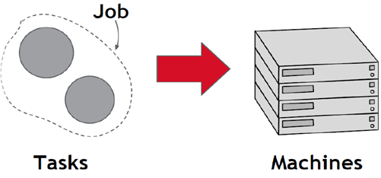
Resource Scheduling – an Overview
Datacenter resources utilization remains prohibitively low – even at the high end of the spectrum of production datacenters, utilizations rarely exceed 20-30%, with most systems operating at even lower utilizations
Goal is to improve the return on investment by raising servers utilization – maximizing operational and capital components of cost efficiencies
A Cluster Scheduler performs the scheduling of workloads to compute resources –makes the “Warehouse-Scale Computer” environment more efficient, increases utilization, and saves energy
Page 4

Slide 5
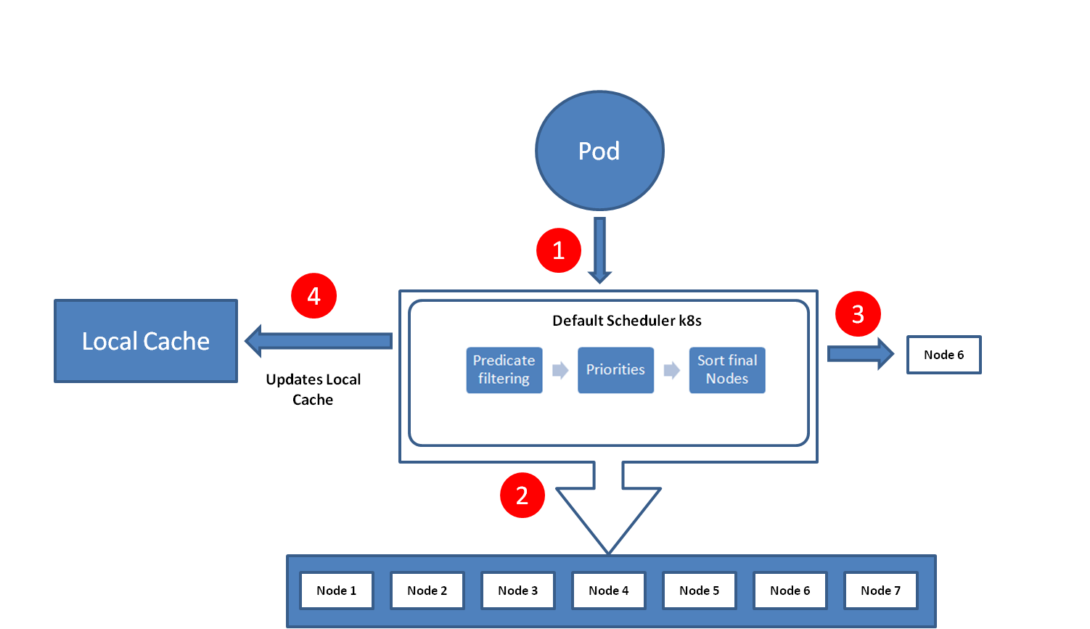
Kubernetes Default Scheduling – an overview
Like any resource scheduling algorithm, Kubernetes has typically two parts – feasibility checking, to find machines on which the task could run, and scoring, which picks one of the feasible machines
In feasibility checking, the scheduler finds a set of machines that meet the task’s constraints and also have enough “available” resources – Fit Predicate Step - Filter the nodes
In scoring, the scheduler determines the “goodness” of each feasible machine – the score takes into account user-specified preferences – Prioritization Step the filtered list of nodes
Finally, select the best fit node – nodes are sorted based on their scores. Node with highest score is selected to host the pod, if multiple nodes with same high-score, one node is selected randomly.
Page 5

Slide 6
Kubernetes Default Scheduling – Limitations
Queue-based scheduling – one pod at a time from a queue of unscheduled pods resulting into issues such as inefficient handling of workloads in the queue requiring machine with the GPU scenario
Low scheduling throughput – for large cluster consiting of 5,000 – 10,000 nodes in it, some jobs could have high waiting time in queue
Low Resource Utilization – problem with the default scheduler is that it does scheduling in a very static manner – essentially, default scheduler does not have any rescheduling capabilities built in, resulting in non-optimal workload scheduling in certain cases
Page 6

Slide 7
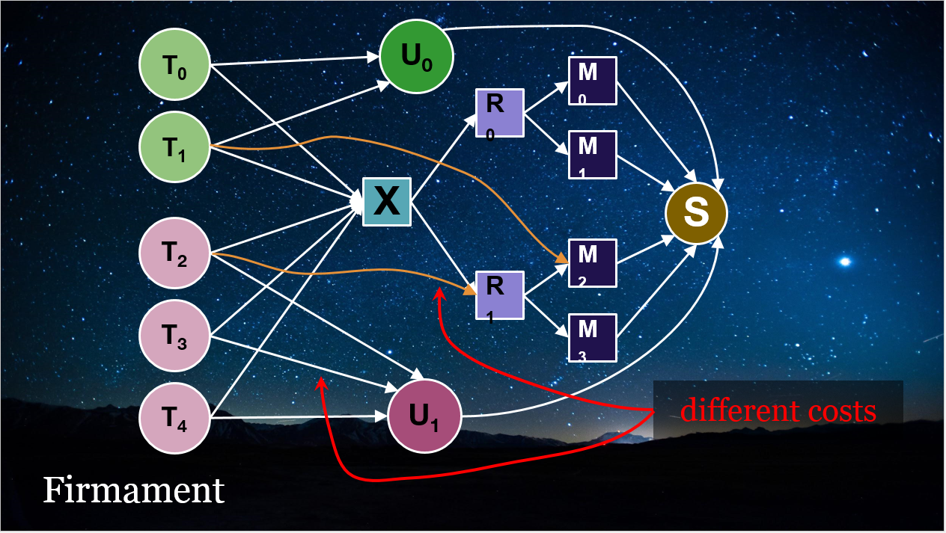
Firmament Scheduler – how it works
Models scheduling problem as a constraint-based optimization over a flow network graph
A min-cost flow algorithm for deriving the implied workload placements
A flow network is a directed graph whose arcs carry flow from source nodes (i.e., pod nodes) to a sink node for a feasible solution to the optimization problem
A cost and capacity associated with each arc constrain the flow, and specify preferential routes for it
Page 7

Slide 8
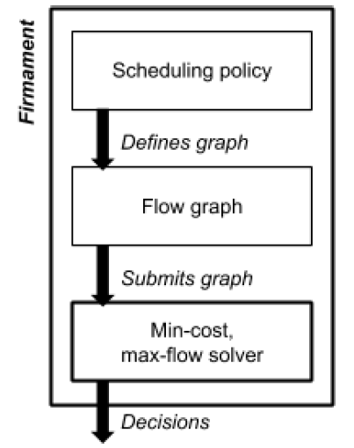
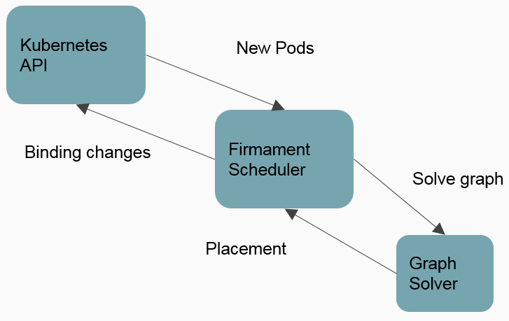
Firmament Scheduling Inner-workings
Page 8

Slide 9
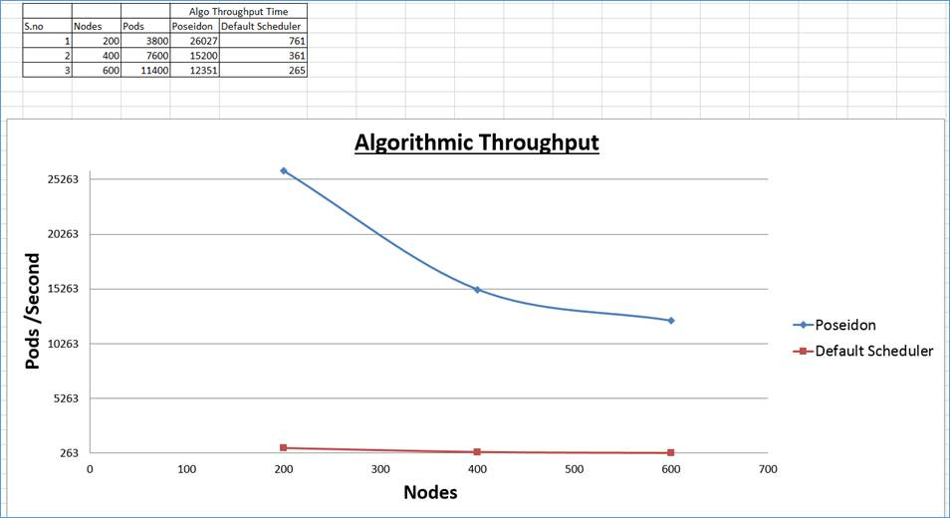
Scheduling Throughput Comparisons
Performance Testing using KubeMark
Page 9

Slide 10
Firmament Scheduler Advantages over K8S Default Scheduler
Highly impressive scheduling throughput
Better decisions improve overall utilization – can pack machines tighter → +20-40% utilization
Workloads are bulk scheduled for enabling low latency (sub second) scheduling decisions at scale – extremely efficient and high quality placement decisions
Firmament provides support for inherent task re-scheduling – in each scheduler run it considers all pods, including running pods, preempting and migrating workloads if prudent – global view of cluster state
Firmament uses actual cluster utilization statistics while placing pods rather than reservations
Pluggable scheduling policies
Page 10

Slide 11
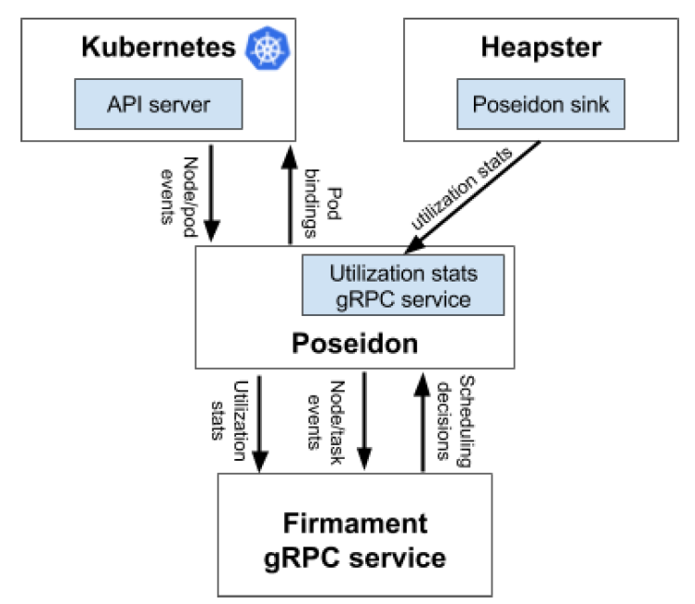
Firmament Kubernetes Integration Design Overview
Page 11

Slide 12
Poseidon – what is it
Poseidon is an integration glue that augments the current Kubernetes scheduling capabilities by incorporating a new flow network graph based Firmament scheduling capabilities alongside the default Kubernetes Scheduler
Each new pod is typically scheduled by the default scheduler, but Kubernetes can be instructed to use another scheduler by specifying the name of another custom scheduler (Poseidon/Firmament, in our case) at the time of pod deployment
In this case, the default scheduler will ignore that Pod and allow Poseidon scheduler to schedule the Pod to a relevant node
Page 12

Slide 13
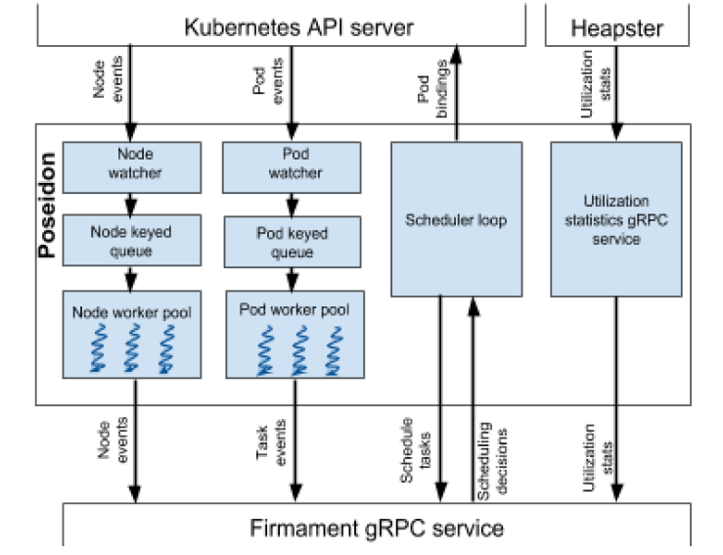
Poseidon Design Overview
Page 13

Slide 14
Poseidon Scheduler Service Mapping
Podwatcher
TaskCompleted
TaskFailed
TaskRemoved
TaskSubmitted
TaskUpdated
NodeWatcher
NodeAdded
NodeFailed
NodeRemoved
NodeUpdated
Firmament Scheduler Service
Stats Service
AddTaskStats
AddNodeStats
Page 14

Slide 15
Kubernetes Object Mapping in firmament
Pod to TaskDescriptor
type TaskDescriptor struct {
Uid uint64
Name string
State TaskDescriptor_TaskState
JobId string
Labels []*Label
ResourceRequest *ResourceVector
}
type Pod struct {
metav1.TypeMeta
metav1.ObjectMeta
Spec PodSpec
Status PodStatus
}
Page 15

Slide 16
Kubernetes Object Mapping in firmament
Node to ResourceTopologyNodeDescriptor
type ResourceTopologyNodeDescriptor struct {
ResourceDesc *ResourceDescriptor
Children []*ResourceTopologyNodeDescriptor
ParentId string
}
type Node struct {
metav1.TypeMeta
metav1.ObjectMeta
Spec NodeSpec
Status NodeStatus
}
Page 16

Slide 17
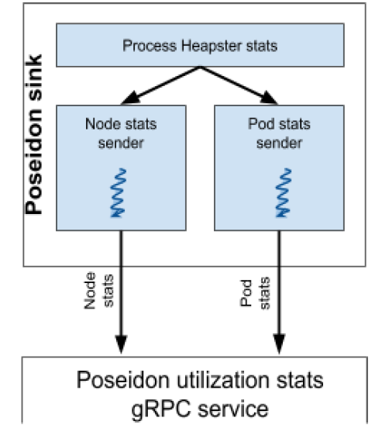
Poseidon Heapster Sink Design Overview
Page 17

Slide 18
Roadmap – what lies ahead
Support for complex constraints (inter task affinity/anti-affinity constraints, ...)
In-depth Resource Utilization benchmarking using various complex workloads such as Tensorflow, Nginx, Spark/Hadoop etc.
Extend the existing CoCo cost model for a more sophisticated policies; such as Load spreading, Co-location Interference, Fairnes etc.
Better Pre-emption
Resource Reclamation
Page 18

